Slide 1
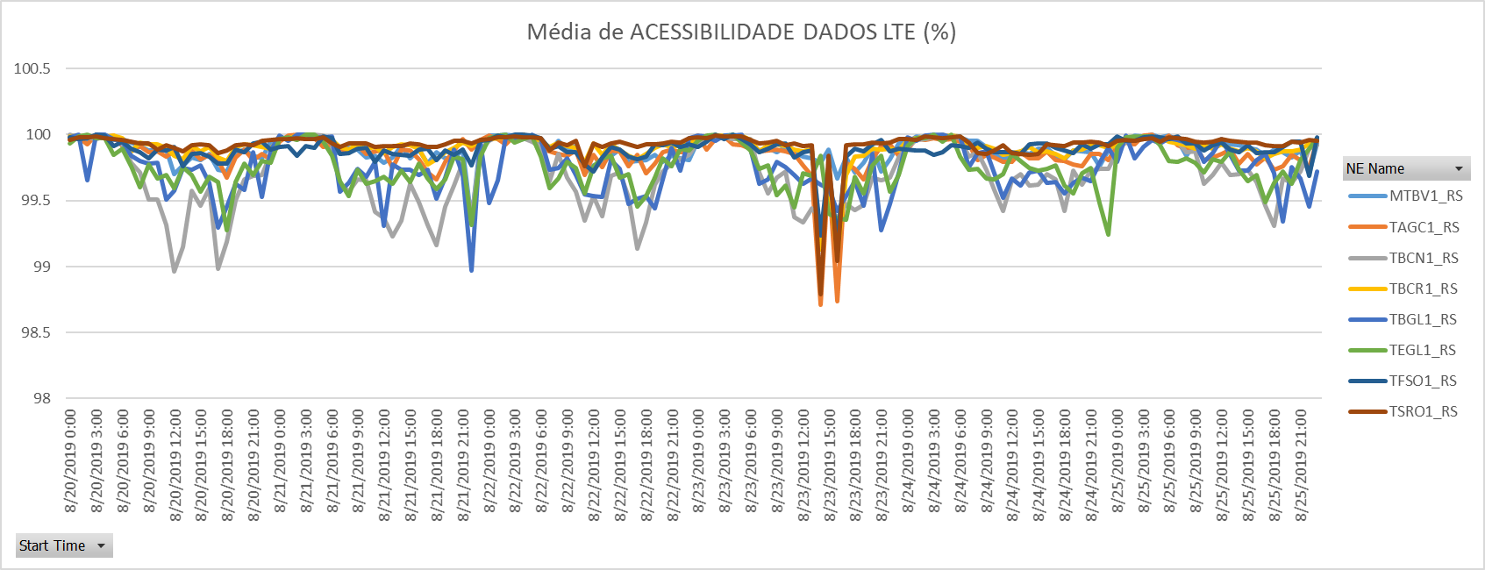
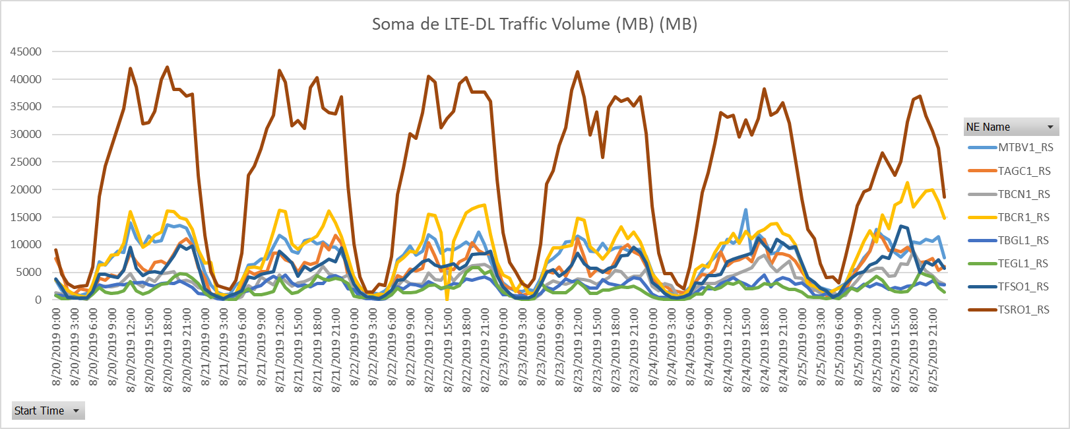
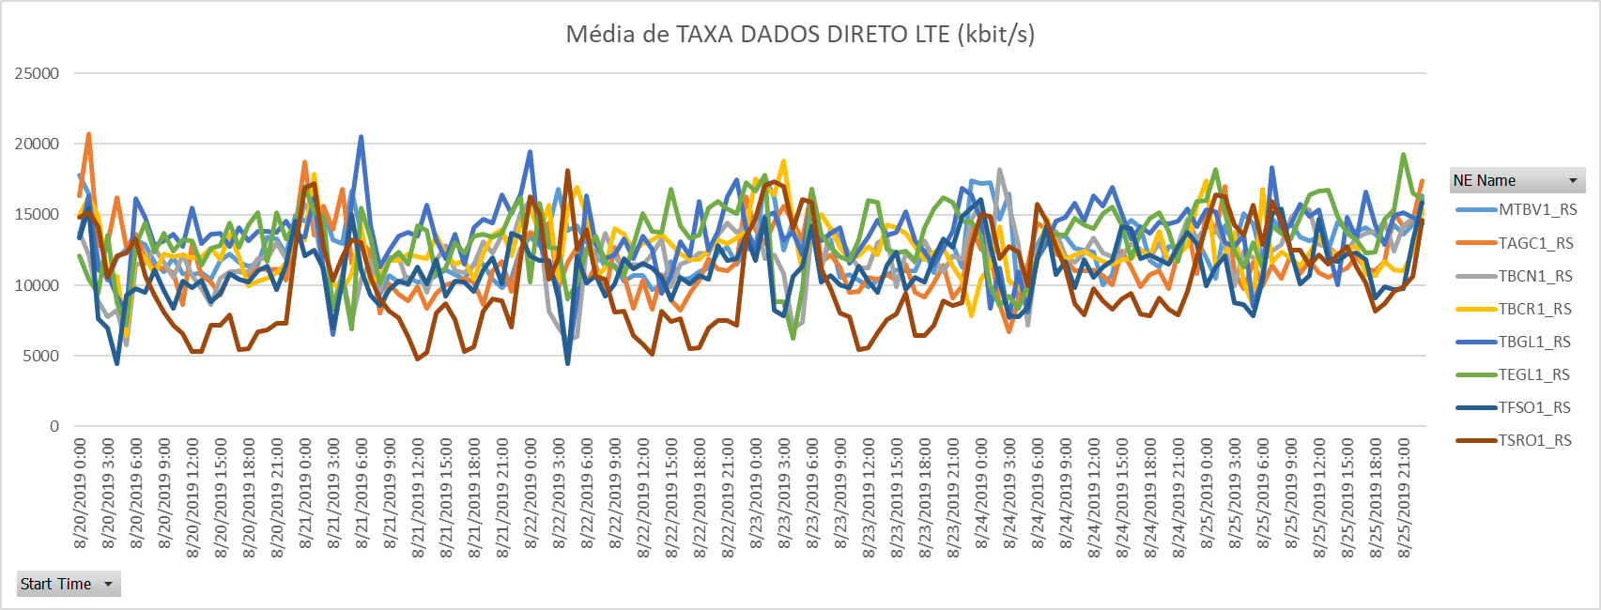
1 – TOP50 – Santa Rosa - LTE
Notes:
RDAP is one of the company’s key profiles includes an ultra high performance, multi vendor, multi technology data extraction platform and an Advanced Analytics solution designed to meet the needs of mobile operation in the next generation network and beyond… Platform is capable of extracting near real time data, historical data, inventory data and data from EMS/NMS.
RDAP powered by KNIME analytics platform to perform Data extraction, transform and load. KNIME analytics platform is a Modular platform for building and running workflows using predefined components. Within KNIME Analytics platform extensive data analytics features are available –Machine Learning algorithms, Statistical, Clustering, Decision trees, for KPI Calculations and reports generation.
RDAP made it simple to Visibility to the network raw counters and provision to create customized KPIs, Automatic dashboard generation in near real time using robotic process by fetching the data from central database.
Some of the major benefits of RDAP are 1) near real time reporting 2) Auto Data pulling from data sources 3) User flavored report formation 4) Maintenance and Audit reports 5) Network Health Management reports 6) Asset Inventory reports etc.

Slide 2
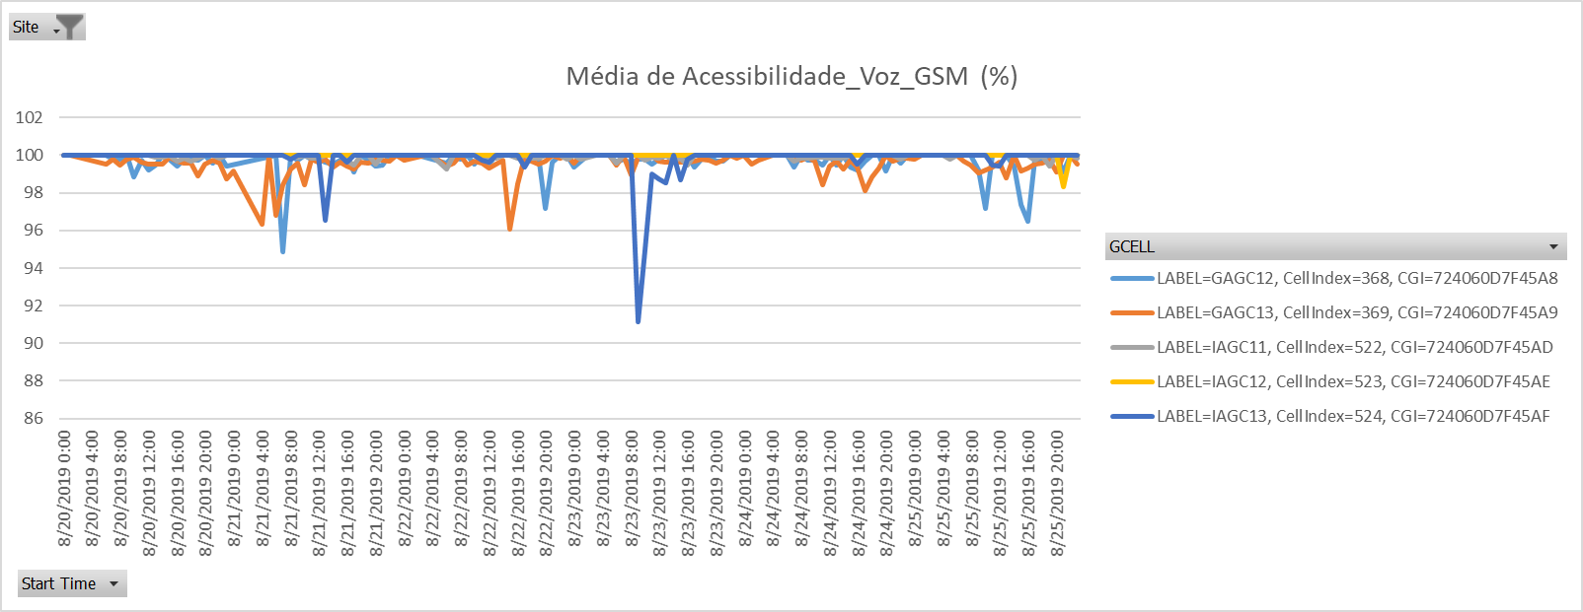
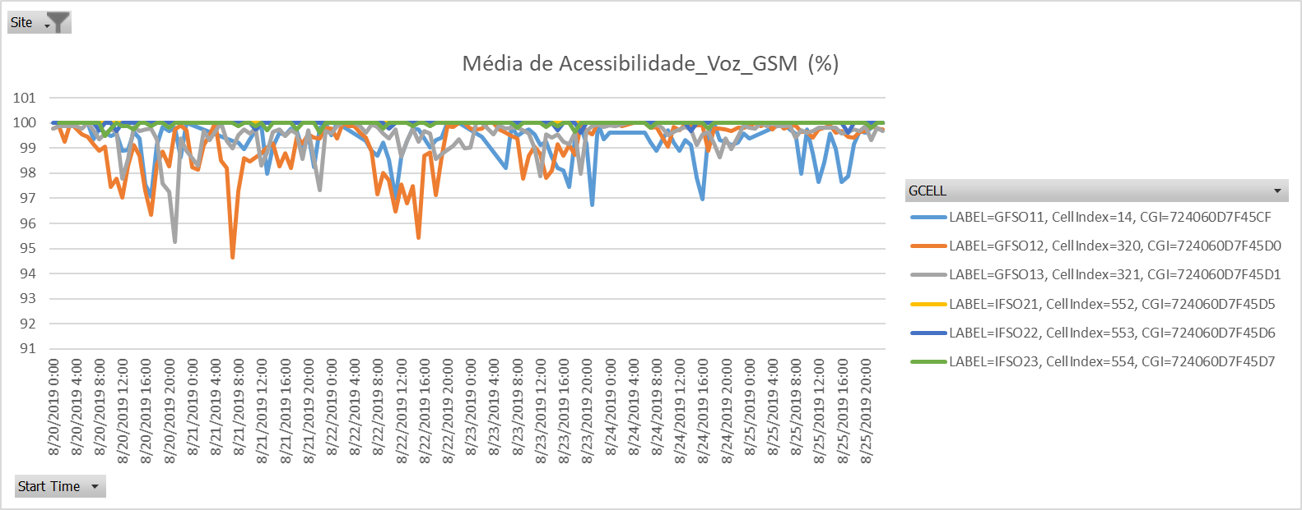
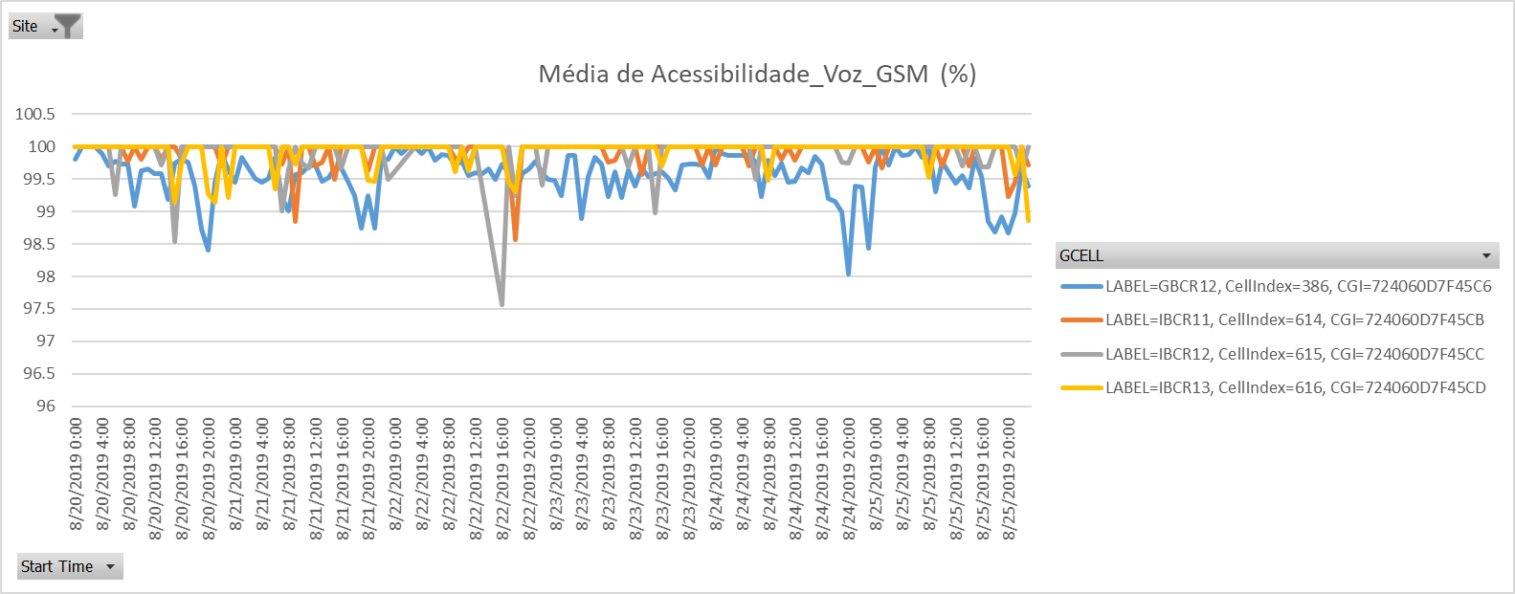
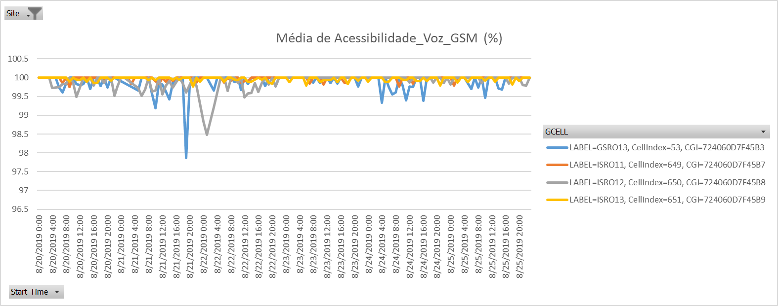
1 – TOP50 – Santa Rosa - GSM
Notes:
RDAP is one of the company’s key profiles includes an ultra high performance, multi vendor, multi technology data extraction platform and an Advanced Analytics solution designed to meet the needs of mobile operation in the next generation network and beyond… Platform is capable of extracting near real time data, historical data, inventory data and data from EMS/NMS.
RDAP powered by KNIME analytics platform to perform Data extraction, transform and load. KNIME analytics platform is a Modular platform for building and running workflows using predefined components. Within KNIME Analytics platform extensive data analytics features are available –Machine Learning algorithms, Statistical, Clustering, Decision trees, for KPI Calculations and reports generation.
RDAP made it simple to Visibility to the network raw counters and provision to create customized KPIs, Automatic dashboard generation in near real time using robotic process by fetching the data from central database.
Some of the major benefits of RDAP are 1) near real time reporting 2) Auto Data pulling from data sources 3) User flavored report formation 4) Maintenance and Audit reports 5) Network Health Management reports 6) Asset Inventory reports etc.

Slide 3
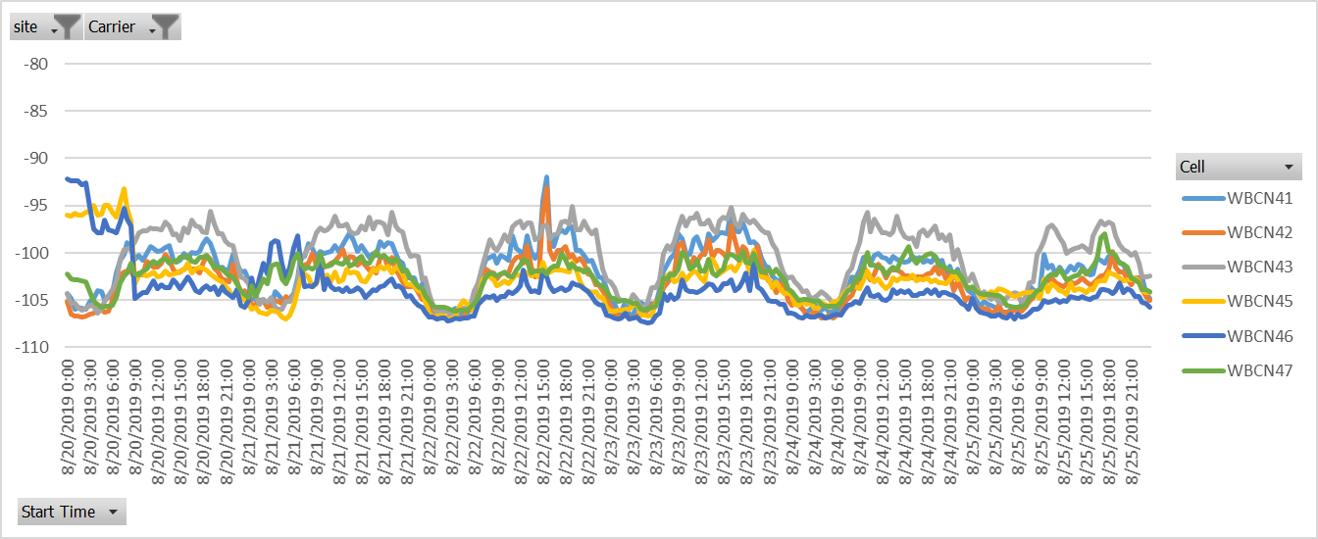
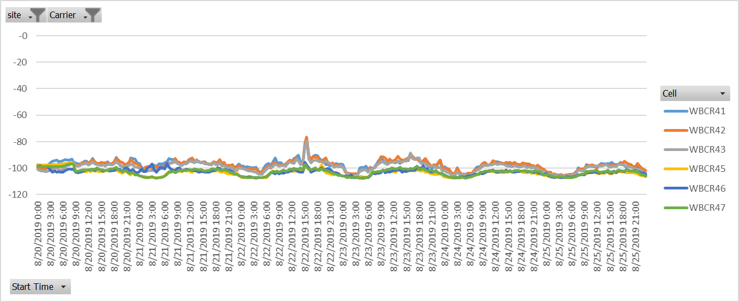
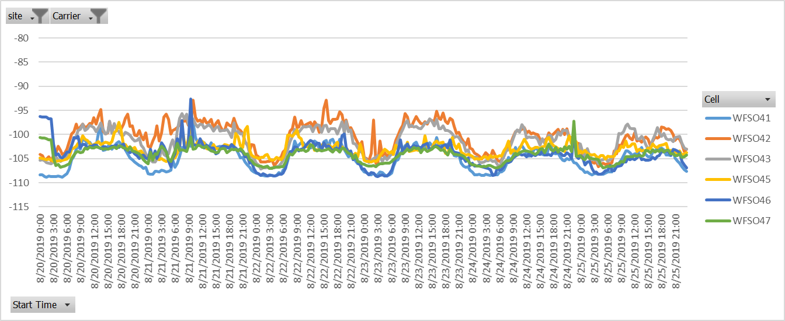
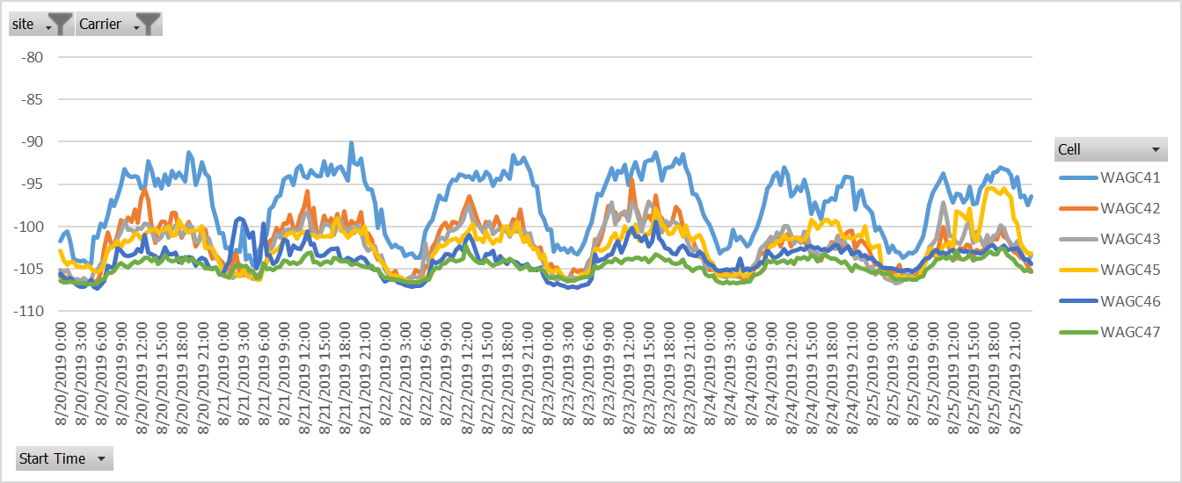
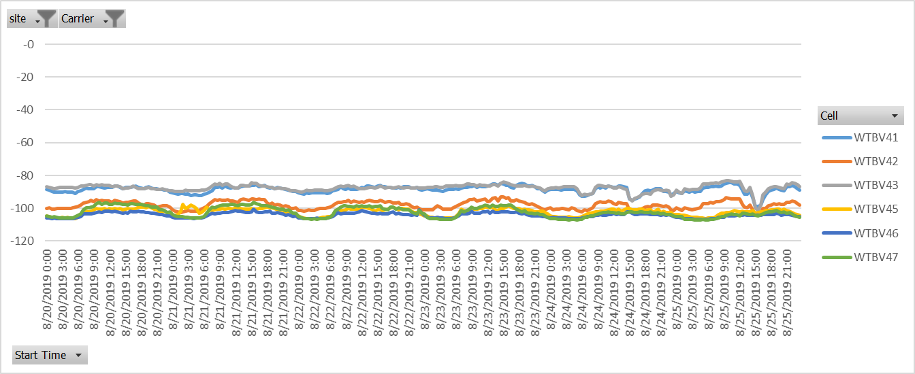
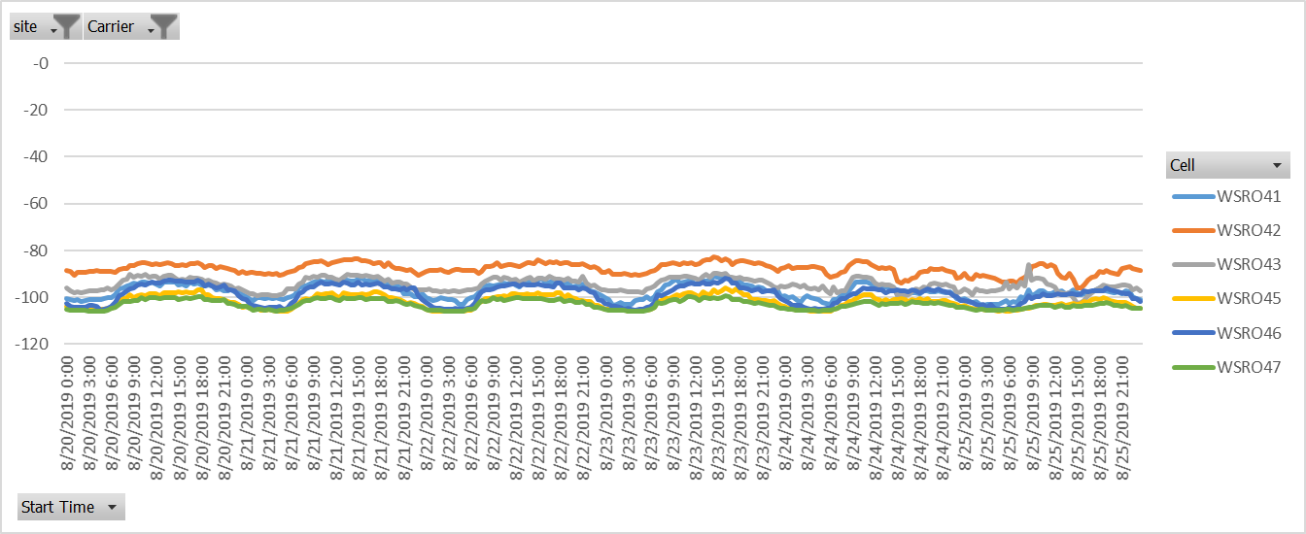
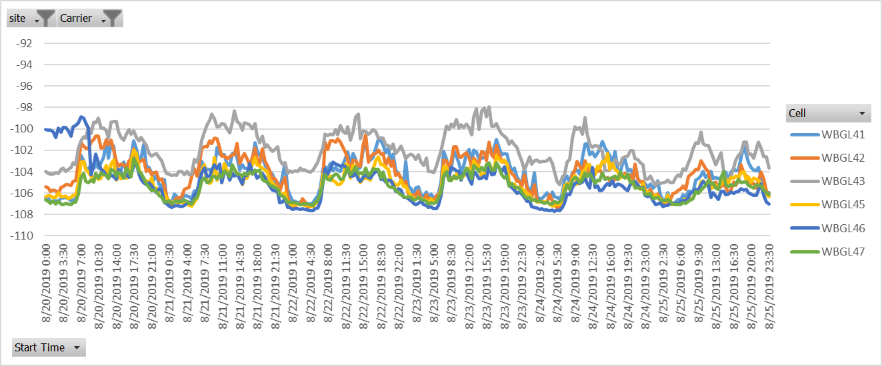
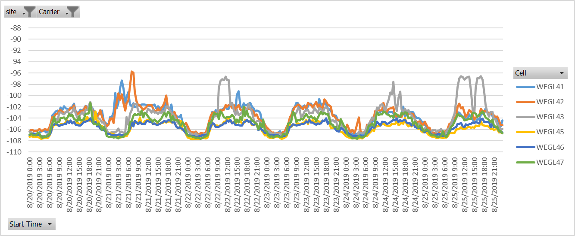
1 – TOP50 – Santa Rosa - WCDMA
Notes:
RDAP is one of the company’s key profiles includes an ultra high performance, multi vendor, multi technology data extraction platform and an Advanced Analytics solution designed to meet the needs of mobile operation in the next generation network and beyond… Platform is capable of extracting near real time data, historical data, inventory data and data from EMS/NMS.
RDAP powered by KNIME analytics platform to perform Data extraction, transform and load. KNIME analytics platform is a Modular platform for building and running workflows using predefined components. Within KNIME Analytics platform extensive data analytics features are available –Machine Learning algorithms, Statistical, Clustering, Decision trees, for KPI Calculations and reports generation.
RDAP made it simple to Visibility to the network raw counters and provision to create customized KPIs, Automatic dashboard generation in near real time using robotic process by fetching the data from central database.
Some of the major benefits of RDAP are 1) near real time reporting 2) Auto Data pulling from data sources 3) User flavored report formation 4) Maintenance and Audit reports 5) Network Health Management reports 6) Asset Inventory reports etc.

Slide 4
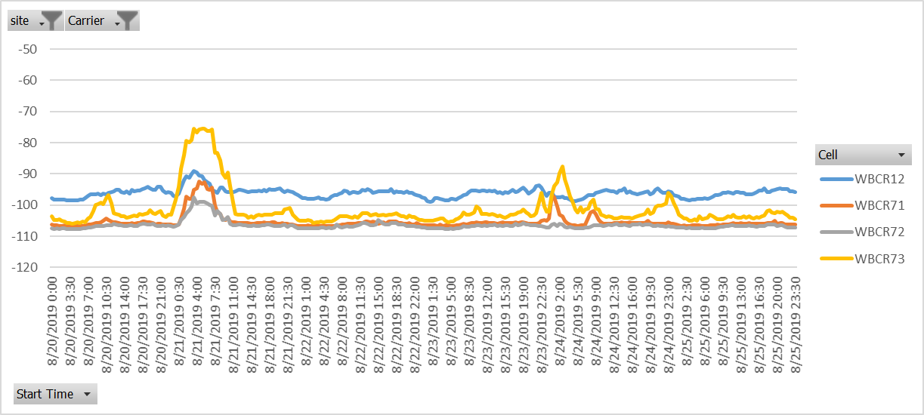
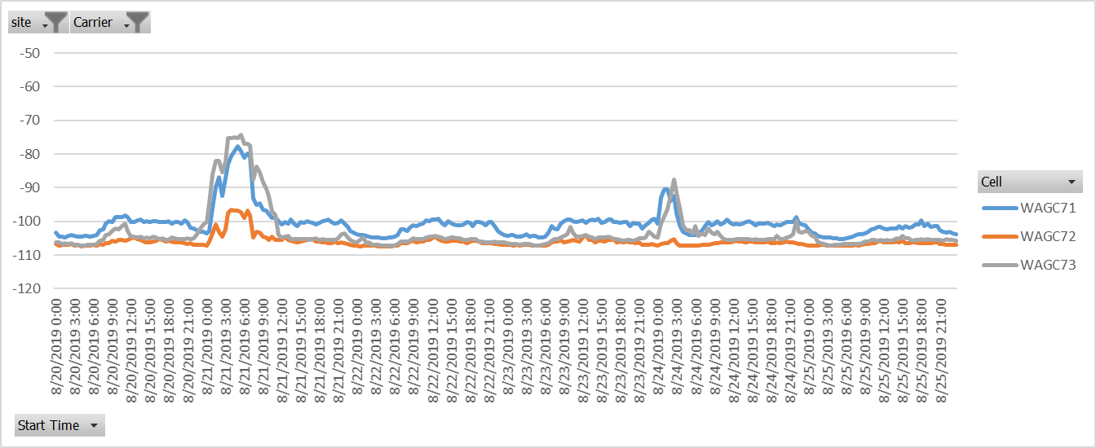
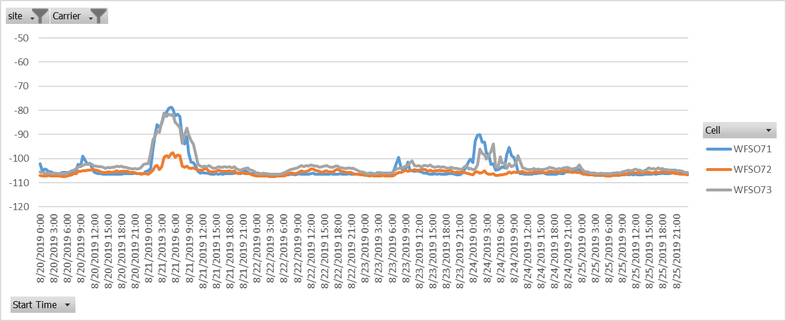
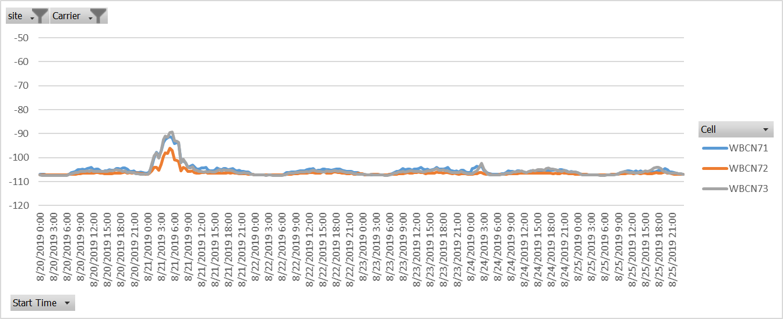
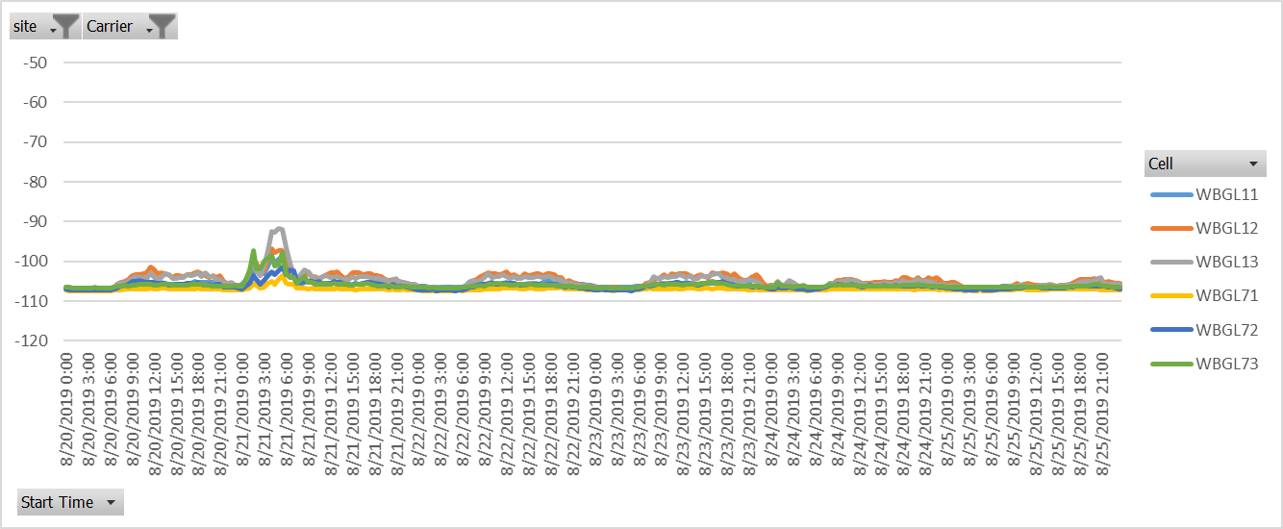
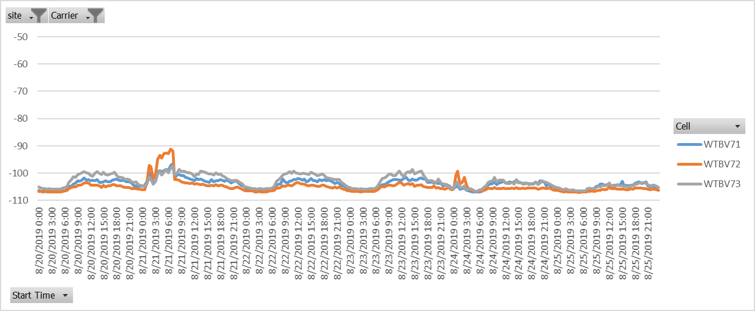
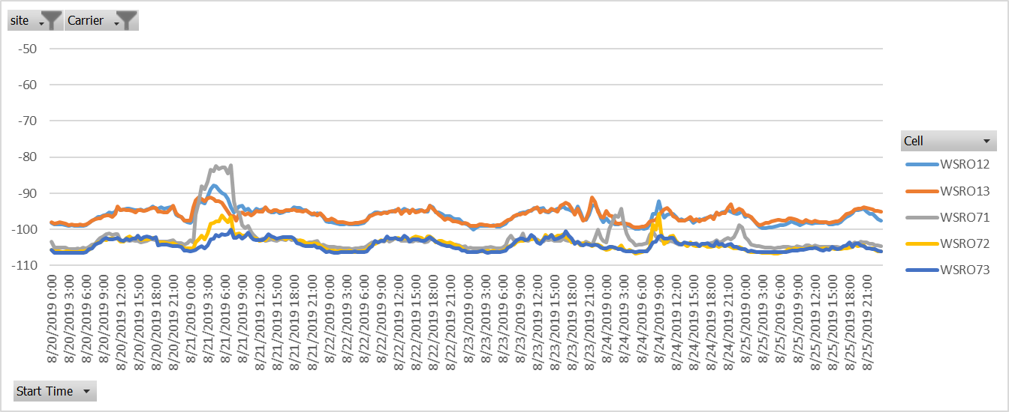
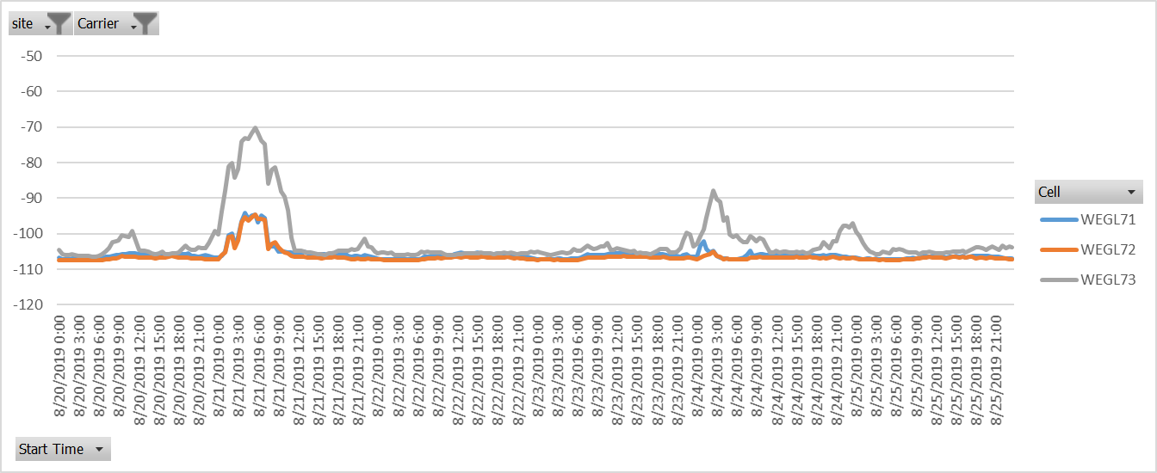
1 – TOP50 – Santa Rosa - WCDMA
Notes:
RDAP is one of the company’s key profiles includes an ultra high performance, multi vendor, multi technology data extraction platform and an Advanced Analytics solution designed to meet the needs of mobile operation in the next generation network and beyond… Platform is capable of extracting near real time data, historical data, inventory data and data from EMS/NMS.
RDAP powered by KNIME analytics platform to perform Data extraction, transform and load. KNIME analytics platform is a Modular platform for building and running workflows using predefined components. Within KNIME Analytics platform extensive data analytics features are available –Machine Learning algorithms, Statistical, Clustering, Decision trees, for KPI Calculations and reports generation.
RDAP made it simple to Visibility to the network raw counters and provision to create customized KPIs, Automatic dashboard generation in near real time using robotic process by fetching the data from central database.
Some of the major benefits of RDAP are 1) near real time reporting 2) Auto Data pulling from data sources 3) User flavored report formation 4) Maintenance and Audit reports 5) Network Health Management reports 6) Asset Inventory reports etc.

